Slide 1

DETECTING ANOMALIES IN MUNICIPAL EXPENDITURES Michelle Cheung
Notes:
Good evening!
Thank you for coming out on a Wednesday night! I definitely understand it’s tough to break away mid-week, but I hope by the end of the night you’ve found what my fellow students and I have worked on was worthwhile and helpful.
For the next couple of minutes, I’ll talk a little about my project where I detected anomalies in municipal expenditures.
It’s a mouthful of a title, but hopefully you’ll enjoy my presentation.

Slide 2


Hello!
Nice to meet you
Background:
Over 11 years as a Structural Engineer designing and evaluating bridges
Master’s Coursework in Structural Design
Contact me at:
Michelle.ann.cheung@gmail.com
https://github.com/MichelleACheung
Notes:
I was a Structural Engineer for 11 years prior to coming to General Assembly and have worked on some awesome bridge projects in the Boston area.
I’ve also done some Master’s coursework in Structural Design.
BUT If you’d like to know more about why I transitioned into Data Science, I’ll leave that as a teaser – I’m here until 8pm tonight!

Slide 3
A Better Chance of Improving
2017 Fiscal Year Data
Process
Findings
Municipalities of any size can make data-backed decisions that reduce crime, lower traffic congestion and improve the environment, among other upgrades. Additionally, governments can determine how to spend money in more intelligent ways.
Notes:
So why should municipalities invest in Data Science?
It take a lot of resources for municipalities to already manage and audit all finances for a city
BUT if a local government takes advantage of Data Science and Analytics
They can make data-backed decisions
They can determine how to spend money in more efficient ways
Most importantly, it’s not only about finding anomalies but also to better understand trends in spending. How can a local government improve? Because no matter what, there’s always room for improvement.
In my presentation, I’ll go over 3 main points of my project:
Where did I get the data for my project?
Talk a little about the process I took
Finally, show some of the anomalies I found in my analysis

Slide 4

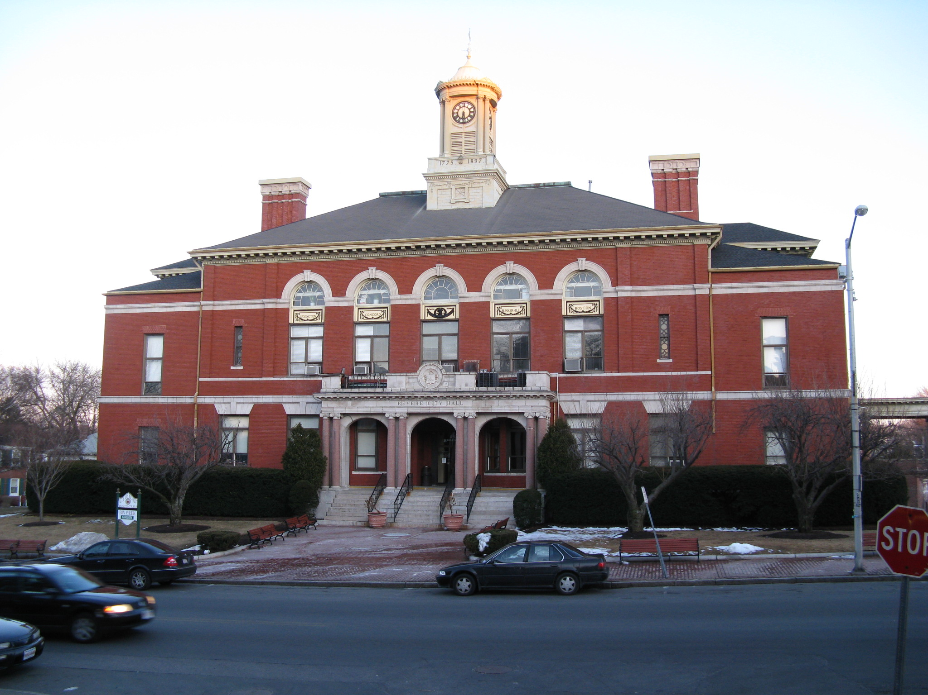
1.
2017 Fiscal Year Data
July 1, 2016 thru
June 30, 2017
Notes:
The local Boston area municipality I did my analysis on – I won’t directly mention
BUT all pictures throughout this presentation are visual hints of the municipality
For my data:
Directly from Auditor’s office for 2017 Fiscal Year
Which ranged from July 2016 through June 2017

Slide 5
2017 Fiscal Year Data
6 Major Entities of Municipal Organization
40+
Departments
54,000 (2017)
Population
Notes:
So some quick statistics on the municipality that I did my project on.
There’s 6 major ‘overseeing’ entities
School Committee
General Government
Public Safety
Public Works
Human Services
Cultural and Recreational
with
More than 40 departments/boards/committees under these 6 entities
The municipality has a population of about 54,000 people
So this municipality is of a pretty significant size

Slide 6
2017 Fiscal Year Data: Expenditures
$ 279,00,000 (approx.) Total of all Expenses*
33,000 (approx.)
Expenses
275
Different Account Descriptions/Categories
Notes:
In 2017, about 279 million dollars totaled in expenses
Which includes total of payroll and non-payroll expenses
In the data, I found approximately 33 thousand expenses made for entire FY.
There were 275 different Account Descriptions or “buckets” where expenses were categorized under

Slide 7
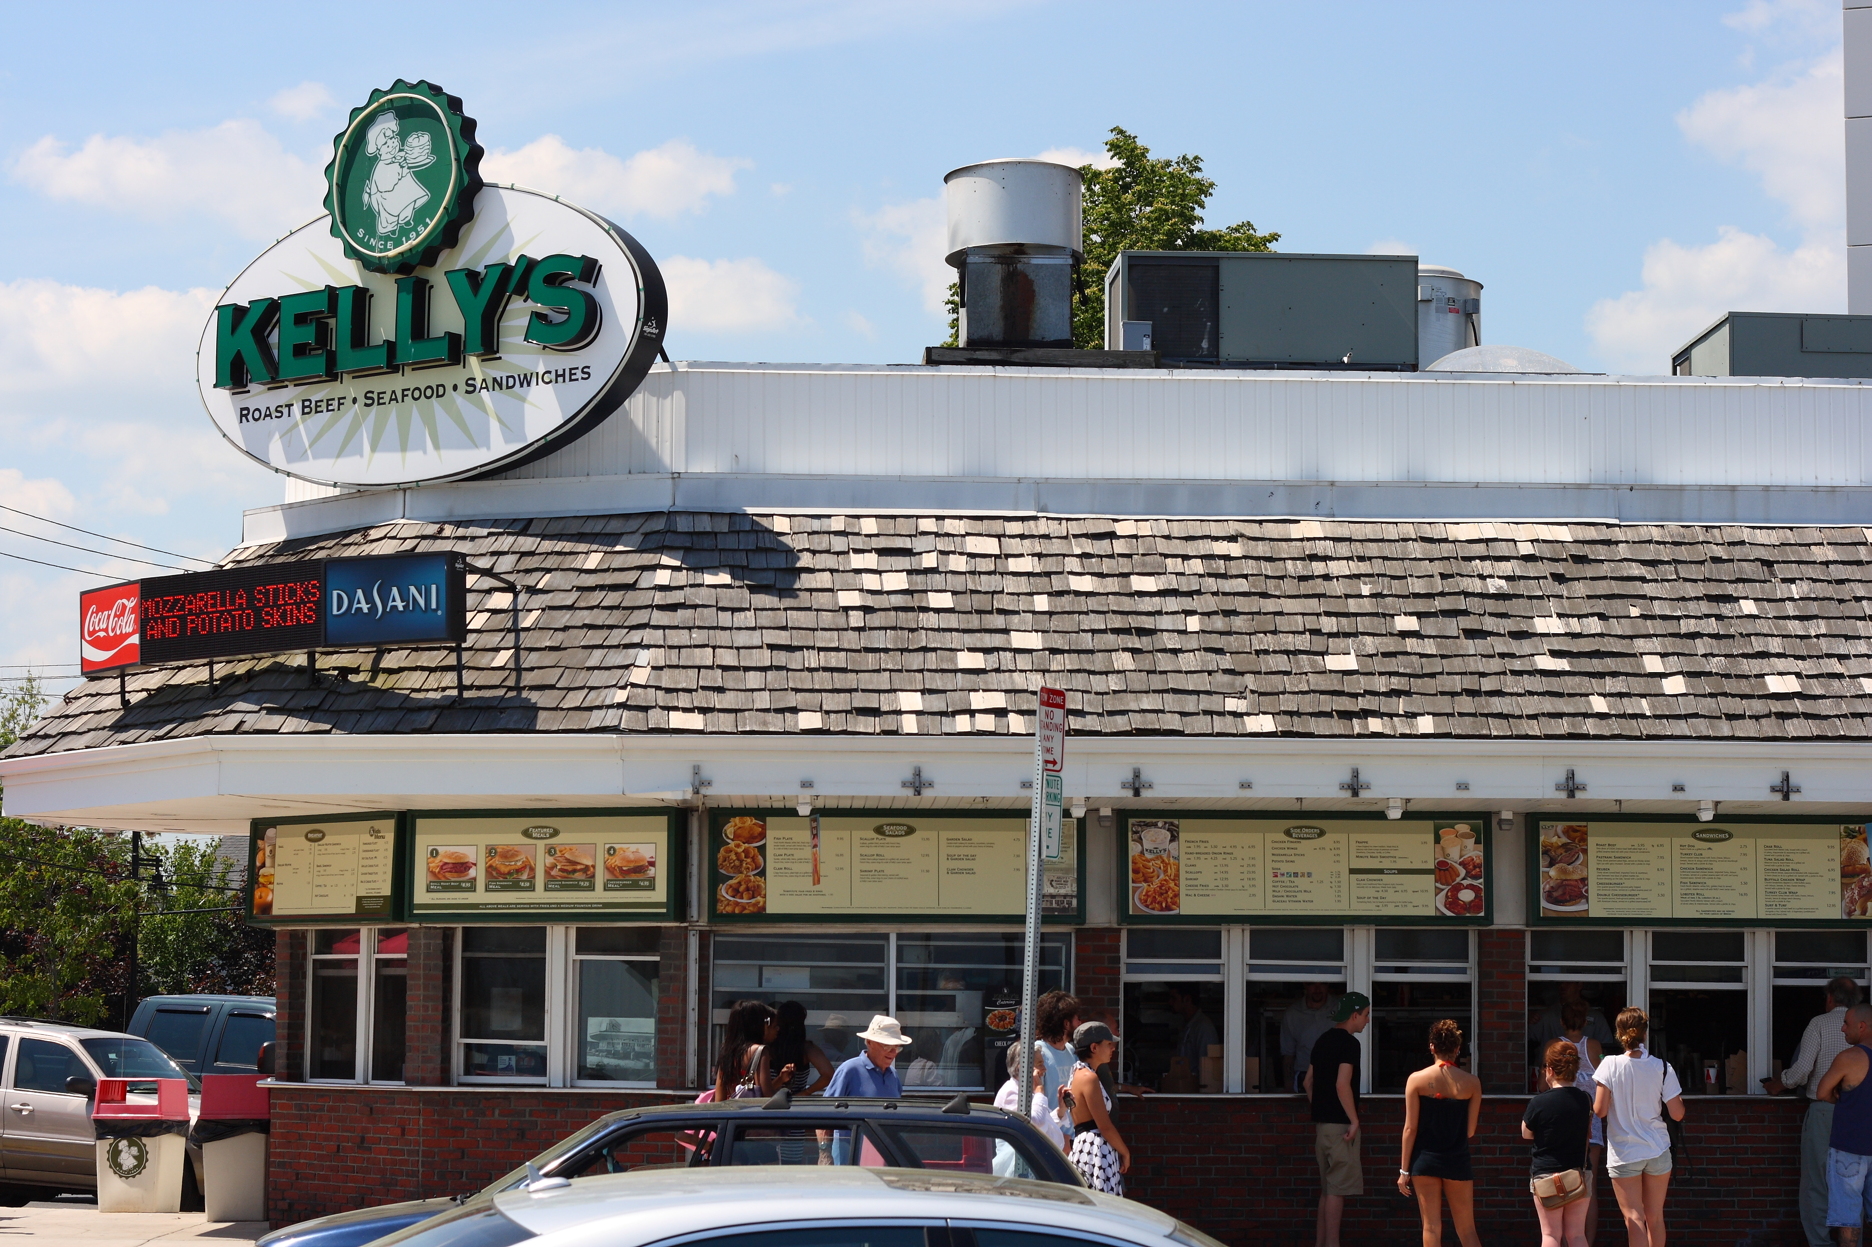
2.
Process
Analysis and Model
Notes:
Not sure if this is a dead giveaway for the municipality, but Kelly’s Roast Beef has some great cheesy fries with bacon!
Now I’ll talk a little about the process I took during my analysis and evaluation.

Slide 8
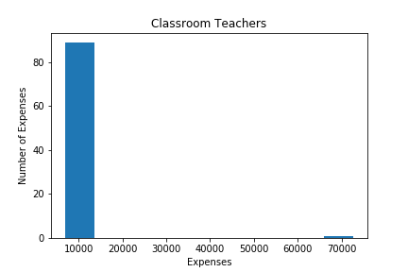
What is an anomaly in expenditure trends?
Notes:
Suppose a department makes a regular amount of fixed expenses or has a regular trend in expense amounts.
In the graph shown here, this department made about 90 expenses in the amount of about 10,000 dollars. But there was also a single expense made in the amount of 70,000 dollars.
What was the reason for that single expense amount?
Simply put, are there any deviations from an expense trend or distribution?

Slide 9
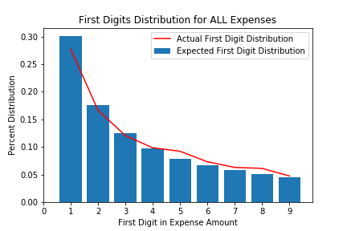
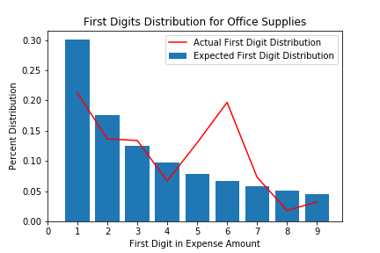
Benford’s Law 👉 An anomaly will alter numbers in such a way that destroys the Benford distribution
$12,250.00
👆First Digit
Notes:
I approached my analysis in two different ways:
I did an analysis with Benford’s Law
Which describes the frequency distribution of first digits in sets of numeric data
You have a set numerical data, you look at the first digit of each number. There’s an expected distribution of how many times that first digit will appear. So in the top graph in blue, if you look at all numbers in the set
The number 1 is expected to appear as a the first digit about 30% of the time
number 2 - 18% of the time
number 3 -13% and so on.
We can EXPECT a certain distribution of the first digit in a set of numeric data with the number one having the highest probability of occurring.
In red, you have the actual distribution of first digits for all the expenses made in the 2017 Fiscal year, which closely satisfies Benford’s Law
But when you start looking at individual departments and their expense trends:
You may find anomalies, or deviations in how often a first digit is occurring
For this example, you’d take a look at expenses made where the first digit is either a 5, 6, or 7

Slide 10
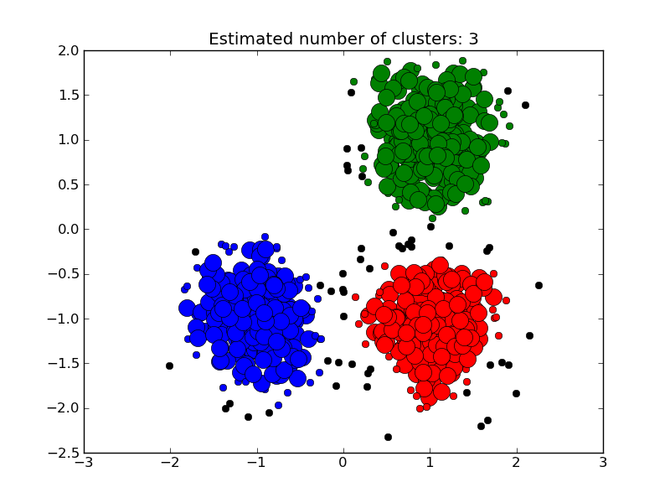
DBSCAN (Density-Based Spatial Clustering of Applications with Noise) 👉 An anomaly will show up as an outlier
Notes:
Second approach I took in my analysis was using a DBSCAN model:
DBSCAN is a method of finding clusters in data and is helpful in detecting outliers/anomalies
I attempted to cluster expense distributions
I passed departments and account descriptions as categorical features using the get_dummies method
I then compared results between my analysis by Benford’s Law and by my DBSCAN model

Slide 11

3.
Findings
Summary of Anomalies in Expenditures
Notes:
Now I’ll show a few of the anomalies I found in my analysis.

Slide 12
Classroom Teachers
Number of Expenses | Average | Number of Anomalies | Amount
89 | $7,400 | 1 | $72,600
Notes:
In the account “Classroom Teachers,” which is an account for the School Committee
I saw that there were about 90 expenses made averaging $7,000.
But then I found that there was a single expense made in the amount of about $72,000.
That’s about a factor of ten for the anomaly found!

Slide 13
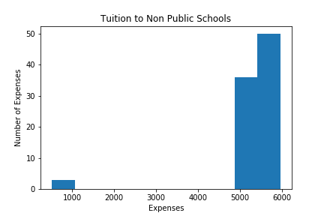
Tuition to Non Public Schools
Number of Expenses | Average | Number of Anomalies | Amount
86 | $5,500 | 3 | $520
Notes:
Tuition to Non Public Schools are expenses towards school programs for kids with special needs
Here I found about 90 expenses made in the amount of over $5,000 dollars, which make sense for tuition fees.
But there were 3 expenses made in the amount of about $500 dollars.
Could these 3 anomalies be another type of fee?

Slide 14
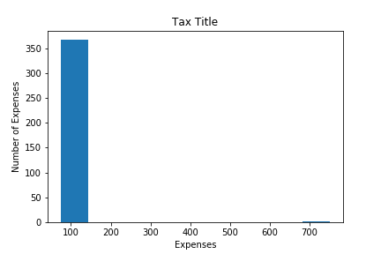
Tax Title
Number of Expenses | Average | Number of Anomalies | Amount
367 | $75 | 1 | $750
Notes:
In the account for “Tax Title”:
I found a almost 400 expenses of a flat $75, which looked to be a fee the municipality paid relative to tax liens
However, I found 1 anomaly in the amount of $750. Exactly ten times the regular expense of $75.
Could this have been an error?

Slide 15
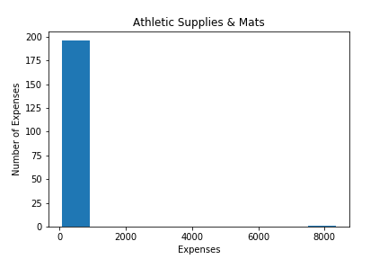
Athletic Supplies & Mats
Number of Expenses | Average | Number of Anomalies | Amount
193 | $82 | 1 | $8,300
Notes:
In the account “Athletic Supplies and Mats,” another account managed by the School committee:
Almost 200 expenses averaged to about $82
One expense stood out at about $8,000.
Could this anomaly have been an one-time kind of expense made towards equipment?

Slide 16
$9,000,000
Approximate Total Amount from Anomalies Found (from large* accounts)
Notes:
Are all of the anomalies I found in my analysis justified?
The summation of anomalies I found in large accounts equaled about 9 million

Slide 17
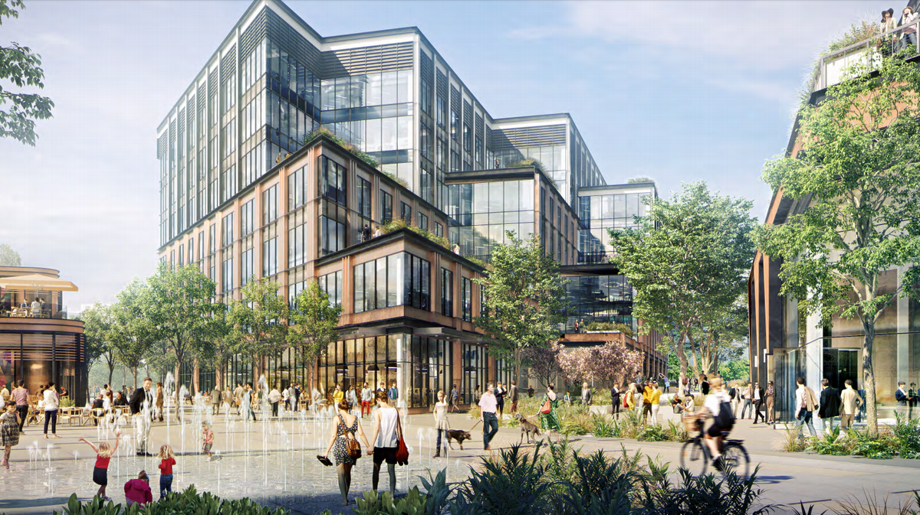
What can a city do with $9,000,000?
Notes:
My findings further emphasize the value of local governments investing in data science.
Local governments can
Make better informed decisions
Be more responsive to citizens
Become more efficient in targeting resources

Slide 18
Next Steps!
Analyze remaining accounts
Try other clustering methods
Try supervised learning method
Further communicate with the municipality
Additional items I’d like to continue working on…
Notes:
Some next steps I’d like to take in my project:
Thus far, I’ve only analyzed accounts that had at least 500 expenses documented for the Fiscal Year
I’d like to look at remaining accounts
I used DBSCAN model to detect outliers.
I’d like to try Support Vector Machine to see how it would handle the varied departments, accounts within a department, and varying distributions of expenses
And most importantly:
it’s probably the busiest time of the year for the municipality as it’s the end of a Fiscal Year.
I was limited in communicating with them as I worked on the project until now, so I’d like to really sit down with them to discuss my findings if they’re interested.

Slide 19

Thank you very much for your time
If you have any questions please don’t hesitate to contact me at:
Michelle.ann.cheung@gmail.com
https://github.com/MichelleACheung
Notes:
THANK YOU ALL FOR YOUR TIME AND I INVITE ANY QUESTIONS AFTER ALL PRESENTATIONS.

